Slide 1
Making Healthy Decisions
Chapter 2

Slide 2
Lesson 1 Making Decisions
Bell Ringer
Write down 5 decisions you have made so far today.
After you complete your list, rate your decisions from a 1-10.
1 meaning an automatic decision and 10 meaning a decision that required careful studying and thought

Slide 3
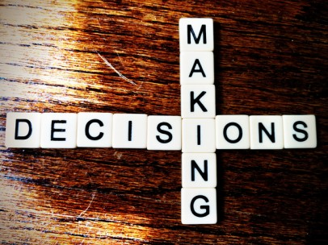
Decision
Control
Decision – a choice you make and act upon
Examples?

Slide 4
Good Decision vs. Bad Decision
Good Decision
Decision in which you have carefully considered the outcome of each choice
Personal Responsibility
Accept how our decision will affect yourself and other people

Slide 5
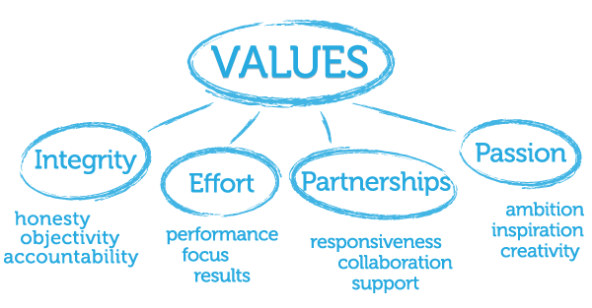
Value
Beliefs that you consider to be of great importance

Slide 6
Character
Is the way people think, feel, & act
Pursuit of Happiness

Slide 7
Steps of Decision Making
1. Identify the Problem
What Choice Do you need to make?
What are the facts?
Who is involved?
2. Consider your values
Right vs. Wrong
3. List the Options
Safe Options
Ask a trusted adult

Slide 8
Steps of Decision Making
4. Weigh the Consequences
H.E.L.P
5. Decide and Act
Choose what is best for you
6. Evaluate your Decision
Was the outcome positive or negative ?
How did you decision affect others?

Slide 9
Decision Making Scenarios

Slide 10
Lesson 2 Influences on Your Decisions
Bell Ringer
Write about a decision that you made in the last year. List factors that influenced your decision.

Slide 11
Influence
A force that affects your choices when you have a decision to make.
Examples:
Family
Peers
Media

Slide 12
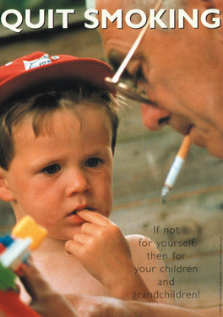
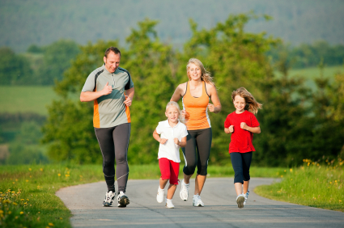
Family
Family Influence
Standards & Expectations
Examples

Slide 13
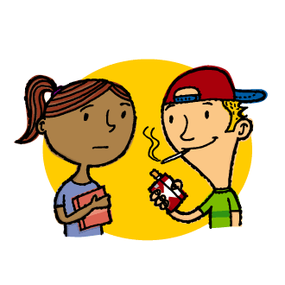
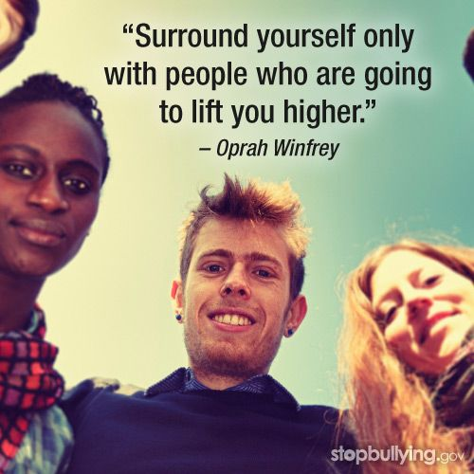
Peers
Peer Pressure
Pressure that you feel to do something because your friends want you to do it
Positive Peer Pressure
Negative Peer Pressure

Slide 14
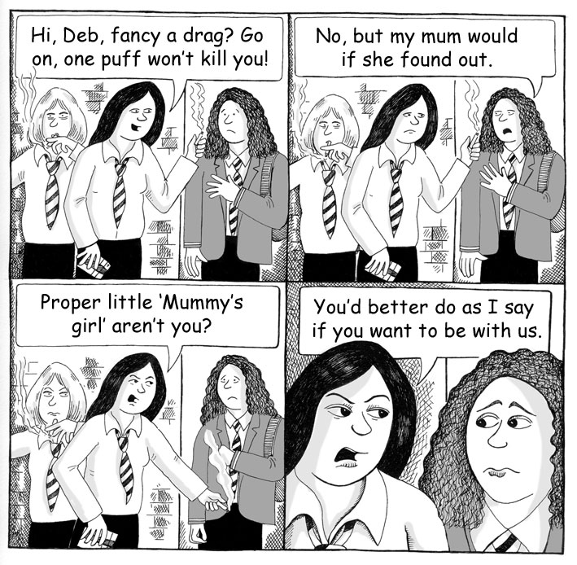

Slide 15
Other Influences
Media
Magazines

Slide 16
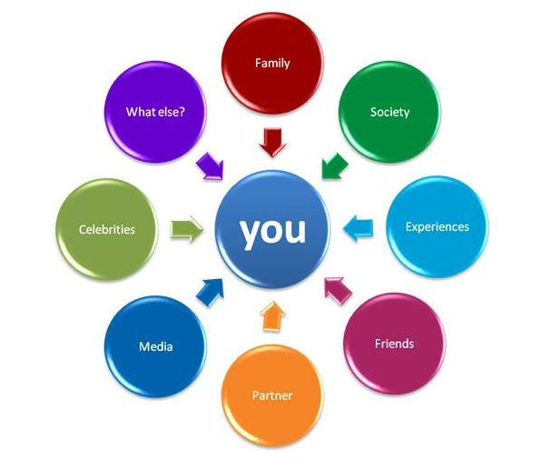
Evaluate Influences
Trustworthy
Caring
Family members & friends
Teachers & Counselors

Slide 17
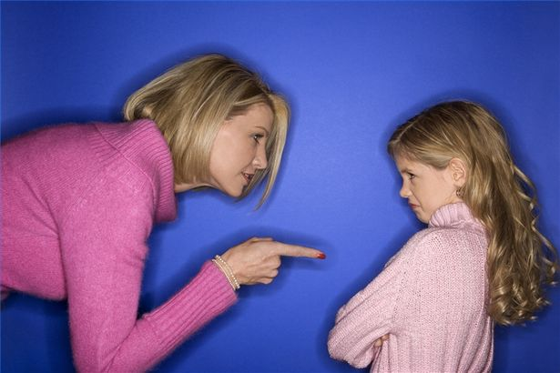
Weighing Consequences
Consequence
Result of an action that you take
Precaution
An action to avoid negative consequences

Slide 18
Decision Making Wheel Activity

Slide 19
Bell Ringer
Write the word “WANTS” at the top of your paper.
Sit quietly until further directions

Slide 20
From Decisions to Goals
Goal
Something that you want and are willing to work for
Self- Esteem
How you feel about yourself as a person and how much you value yourself

Slide 21
Types of Goals
Short Term Goals
Tasks that you can accomplish in a short period of time
Long Term Goals
Tasks that usually take weeks, months, or even years to accomplish

Slide 22
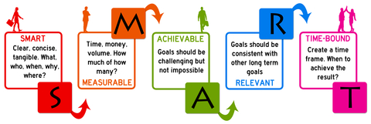
SMART Goals

Slide 23
Interests & Values
Goals
Based on your values & interests
Interest
Something that you enjoy and want to learn more about
May share the same goals as others
Goals may change as your interests do

Slide 24
Your goals and other people
Help
Encouragement
Support
Parents, friends, coaches, teachers

Slide 25
Life Skills Activity

Slide 26
Having Success
Success
Achievement of your goal
Action Plan
Map that outlines the steps for reaching your goal
1. Write down the goal
2. Find information that you need to reach your goal
3. How long will it take to reach?
4. Check progress
5. Reward yourself after the goal was accomplished

Slide 27
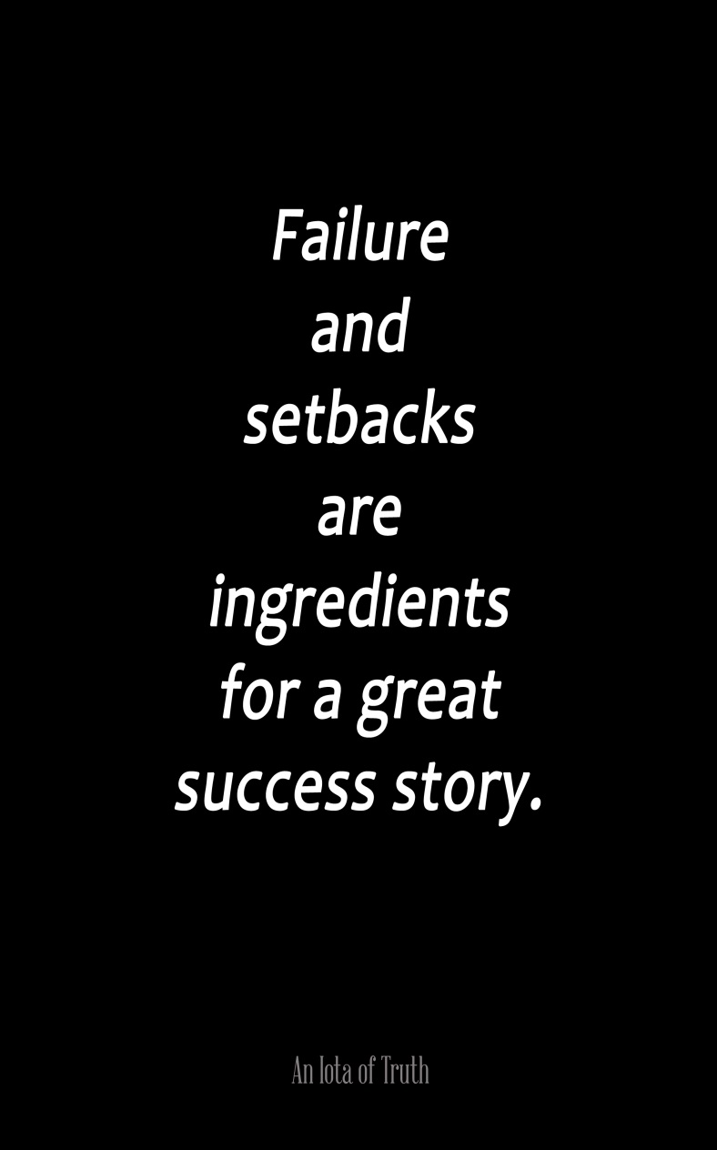
Setbacks
Setback
Something that goes wrong
Learning opportunities
Setbacks vs. Failure
Persistence
Commitment to keep working toward your goal even when things happen that make you want to quit

Slide 28
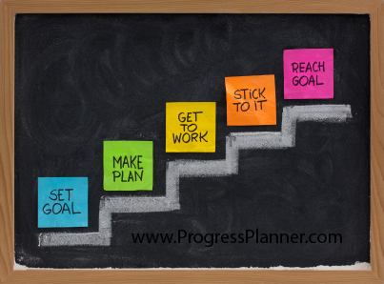
Assessing Your Progress
Assess
Measure your short term achievement towards a long term goal
Journals, Charts

Slide 29
Changing Your Goals
Switching goals
Making changes of your goals
Coping
Dealing with problems and troubles in an effective way
Taking breaks
Working on something else

Slide 30
Lesson 7 Communication Skills
Bell Ringer
What are strengths & weaknesses when we’re talking about communication?
How can communication skills be improved?

Slide 31
Communicating Clearly
Communication Skills
Methods for expressing your thoughts and listening to what others say
Stay Focused
Choose words carefully
Body Language

Slide 32
Listening Skills
Active listening
Not only hearing what a person says but also showing that you understand what the person is communicating
Face the person you are talking to
Make eye contact
Avoid misunderstandings
Summarizing

Slide 33
Snowflake Activity

Slide 34
Saying No !
Refusal skills
Different ways of saying no to things that you don’t want to do
Say no
Stay focused on the issue
Stand your ground
Walk away
Avoid risky situations

Slide 35
Have a support system
Support system
Made up of family members and friends who will stand by you and will encourage you when times get hard
Family
Friends
Teachers
Coaches
Anyone that you can trust

Slide 36
Circles of Support Activity

